Slide 1

Artifacts rejection and frequency band visualisation in eeg signals
Presented by-Yajash Goplani

Slide 2
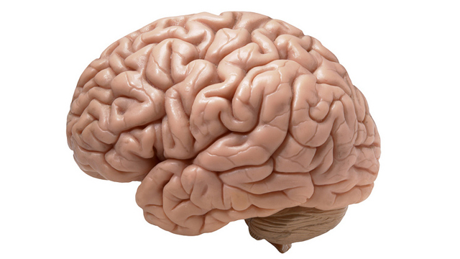
INTRODUCTION
The human brain is the command center for the human nervous system. It receives signals from the body's sensory organs and outputs information to the muscles.
It controls most of the activities of the body, processing, integrating, and coordinating the information it receives from the sense organs, and making decisions as to the instructions sent to the rest of the body.
Functional neuroimaging, and Electroencephalography (EEG) recordings are important in studying the brain.

Slide 3

NEURONS
Neurons is an electrically excitable cell that communicates with other cells via specialized connections called synapses.
Neurons are of three types:
Sensory Neurons
Motor neurons
Interneurons
EEG measures voltage fluctuations resulting from ionic current within the neurons of the brain.
Each conscious and unconscious mental function is the result of the electrical communication among the human brain neurons.

Slide 4
BRAIN LOBES
The cerebral cortex is what we see when we look at the brain. It is the outermost portion that can be divided into the four lobes of the brain. Each bump on the surface of the brain is known as a gyrus, while each groove is known as a sulcus.
Various lobes of Brain:
Frontal lobe
Occipital lobe
Temporal lobe
Parietal lobe

Slide 5
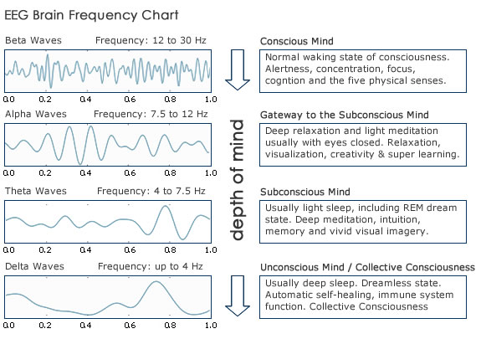
BRAIN WAVES
All our thoughts, emotions and behaviours is the communication between neurons within our brains. Brainwaves are produced by synchronised electrical pulses from masses of neurons communicating with each other.
Our brainwaves change according to what we’re doing and feeling. When slower brainwaves are dominant we can feel tired, slow, sluggish, or dreamy. The higher frequencies are dominant when we feel wired, or hyper-alert.
Infra –low (<0.5HZ)
Delta Waves (0.5HZ to 3HZ)
Theta Waves (3HZ to 7.5HZ)
Alpha Waves (7.5HZ to 12HZ)
Beta Waves (12HZ to 30 HZ)
Gamma Waves (>30HZ)

Slide 6
EEG(Electroencephalography)
EEG refers to the recording of the brain's spontaneous electrical activity over a period of time, as recorded from multiple electrodes placed on the scalp. EEG is measure of electrical signals emitted by the human brain.
EEG is particularly useful for evaluating patients with suspected seizures, epilepsy, stress ,depression and unusual spells.
An unfortunate reality of EEG is that cerebral activity may be overwhelmed by other electrical activity generated by the body or in the environment.
EEG uses the principle of differential amplification, or recording voltage differences between different points using a pair of electrodes that compares one active exploring electrode site with another neighboring or distant reference electrode.
By convention, when the active exploring electrode G1 is more negative than the reference electrode G2, the EEG potential is directed above the horizontal meridian (i.e., an upward wave), whereas if the opposite is true, where the reference electrode is more negative, the EEG potential vector is directed below the horizontal meridian.
A related technique to the EEG is MEG, which does not record electrical activity but, rather, utilizes sensors to capture magnetic fields generated by the brain.

Slide 7
HISTORY OF EEG
In 1875, Richard Caton(1842–1926), a physician practicing in Liverpool, presented his findings about electrical phenomena of the exposed cerebral hemispheres of rabbits and monkeys in the British Medical Journal.
In 1890, Polish physiologist Adolf Beck published an investigation of spontaneous electrical activity of the brain of rabbits and dogs that included rhythmic oscillations altered by light.
In 1912, Ukrainian physiologist Vladimir Vladimirovich published the first animal EEG and the evoked potential of the mammalian(dog)
German physiologist and psychiatrist Hans Berger (1873–1941) recorded the first human EEG in 1924.
In 1935, Gibbs, Davis and Lennox described interictal spike waves and the three cycles/s pattern of clinical absence seizures, which began the field of clinical electroencephalography. Subsequently, in 1936 Gibbs and Jasper reported the interictal spike as the focal signature of epilepsy.
. In October 2018, scientists connected the brains of three people to experiment with the process of thoughts sharing. Five groups of three people participated in the experiment using EEG. The success rate of the experiment was 81%.

Slide 8
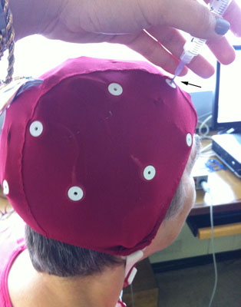
EEG ELECTRODES AND GEL
Small metal discs usually made of stainless steel, tin, gold or silver covered with a silver chloride coating. They are placed on the scalp in special positions.
Each electrode site is labeled with a letter and a number. The letter refers to the area of brain underlying the electrode e.g. F- Frontal lobe and T - Temporal lobe. Even numbers denote the right side of the head and odd numbers the left side of the head.
Gel acts as a malleable extension of the electrode, so that the movement of the electrodes cables is less likely to produce artifacts. The gel maximizes skin contact and allows for a low-resistance recording through the skin.
The higher the impedance of the electrode, the smaller the amplitude of the EEG signal. In EEG studies, should be at lest 100 ohms or less and no more than 5 kohm.

Slide 9
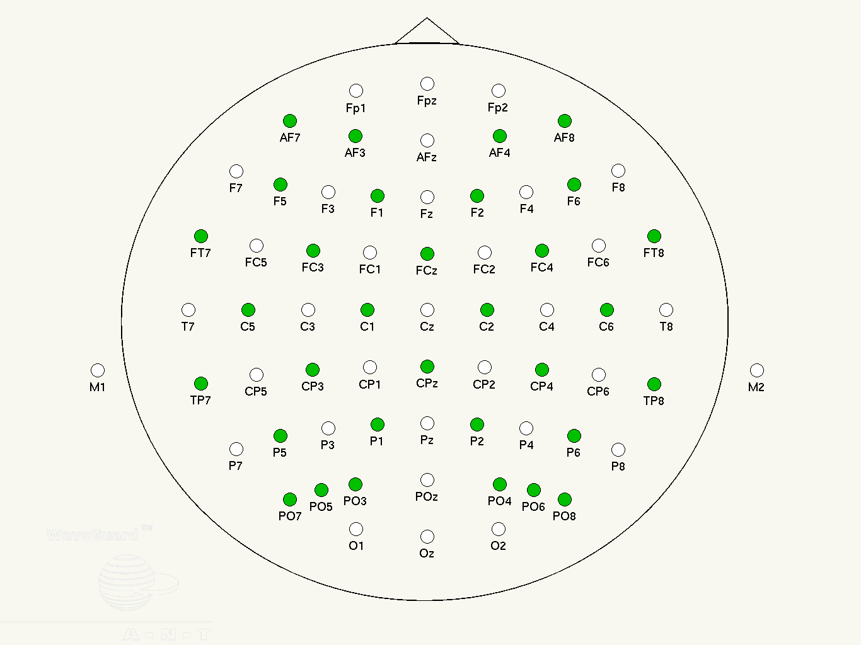
10-20 SYSTEM
The 10–20 system or International 10–20 system is an internationally recognized method to describe and apply the location of scalp electrodes
The system is based on the relationship between the location of an electrode and the underlying area of the brain, specifically the cerebral cortex
The "10" and "20" refer to the fact that the actual distances between adjacent electrodes are either 10% or 20% of the total front–back or right–left distance of the skull.
These scalp electrodes are used to record the electroencephalogram (EEG) using a machine called an electroencephalograph.

Slide 10
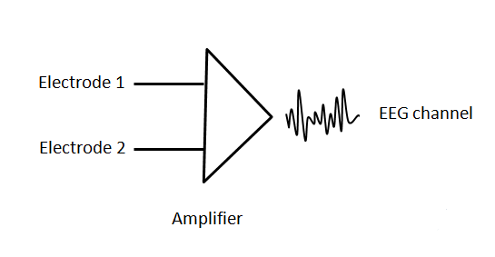
ELETRODE MONTAGE
The manner in which pairs of electrodes are connected to each amplifier of the EEG machine is called montage.
Types of electrode montage
Common reference derivation
Average reference derivation
Bipolar derivation

Slide 11
ARTIFACTS
Artefacts are unwanted noise signals in an EEG record. Classification of artefacts based on source of its generation like physiological artefacts and external artefacts. Body of the subjects are main source of Physiological artifacts, while external artefacts are from outside the body due to the environment or measuring devices.
Classification of Artifacts:
Physiological Artifacts
Eyelids
Eye Movement
Eye Blink
Muscle Artifacts
Cardiac Artifacts
External Artifacts

Slide 12
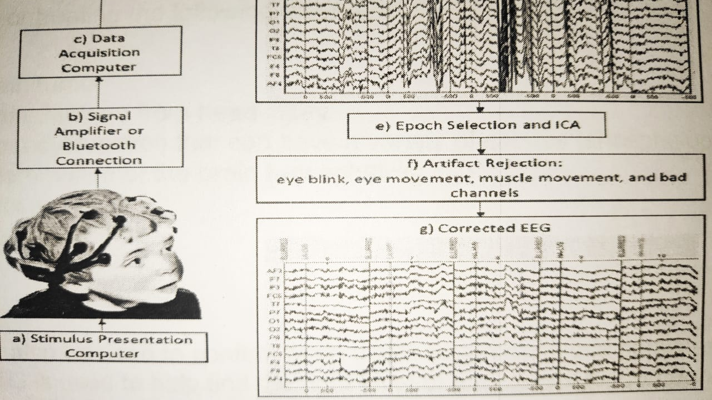
BASIC BLOCK DIAGRAM OF EEG PROCESSING

Slide 13
EEG PROCESSING
The first thing we need is some raw EEG data to process. This data is usually not clean so some processing steps are needed.
These often include the application of filters, such as a high pass filter to remove the DC components of the signals and also the drifts. A low pass filter can also be applied to remove the high frequency components. In EEG we currently rarely study frequency above 90 Hz which Correspond to the Gamma range.
After that there many preprocessing techniques which we have to apply. The reason is that blinks and eye movements generate strong electrical fields that effect our EEG .
Once are signal is cleaned ,it is quite comman to cut them into epochs of few seconds and then extract features from each one of these.
The electrodes detect your brain waves and the EEG machine amplifies the signals and records them in a wave pattern on graph paper or a computer screen.

Slide 14
Principal Component Analysis
Principal components analysis (PCA) is a technique that can be used to simplify a dataset, more fomally it is a linear transformation that chooses a new coordinatesystem for the data set such that the greatest variance by any projection of the data set comes to lie on the first axis (then called the first principal component). the second greatest variance on the second axis, and so on. PCA can be used for reducing dimensionality in a dataset while retaining those characteristics of the dataset that contribute most to its variance by eliminating the later principal components
Principal Components Analysis is comprehensively presented in many multivariate statistics textbooks, such as Jolliffe and Lebart et , and only a brief introduction is given here. From p variables observed on n objects (an n × p matrix), that is, a raw data matrix X, PCA derives new variables as linear combinations of the original ones, defined from a new orthogonal coordinate system onto which the original space is projected. This new system summarizes the total data variation in decreasing order so that the first new variable has the largest variation, the second has the second largest, and so on. These new variables are the principal components. The singular value decomposition (SVD) is used to estimate this new orthogonal space, by factoring X
X = U × D × V^{T}
The major limitations of the method are its inability to completely separate some artifacts from cerebral activity, especially when both have similar amplitudes

Slide 15
Code of pca in python
import numpy as np
import matplotlib.pyplot as plt
from sklearn.preprocessing import StandardScaler
from sklearn.decomposition import PCA
import pandas as pd
import Lbeep
d=Lbeep.read_cnt('mi.cnt')
s=d.get_sample_count()
fs=d.get_sample_frequency()
c=d.get_samples(1,s)
q=np.array(c)
q1=q.reshape(618483,64)
q2=pd.DataFrame(q1)
x=StandardScaler()
x.fit(q2)
q3=x.transform(q2)
q4=pd.DataFrame(q3)
pca=PCA()
pca.fit(q4)
per_var=np.round(pca.explained_variance_ratio_*100,decimals=1)
labels=['PC'+str(x) for x in range(1,len(per_var)+1)]
plt.bar(x=range(1,len(per_var)+1),height=per_var,tick_label=labels)
plt.show()

Slide 16
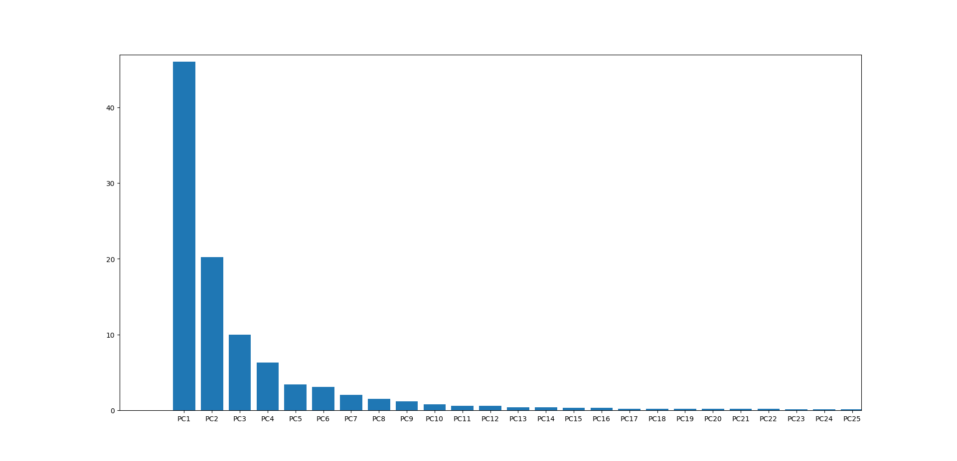
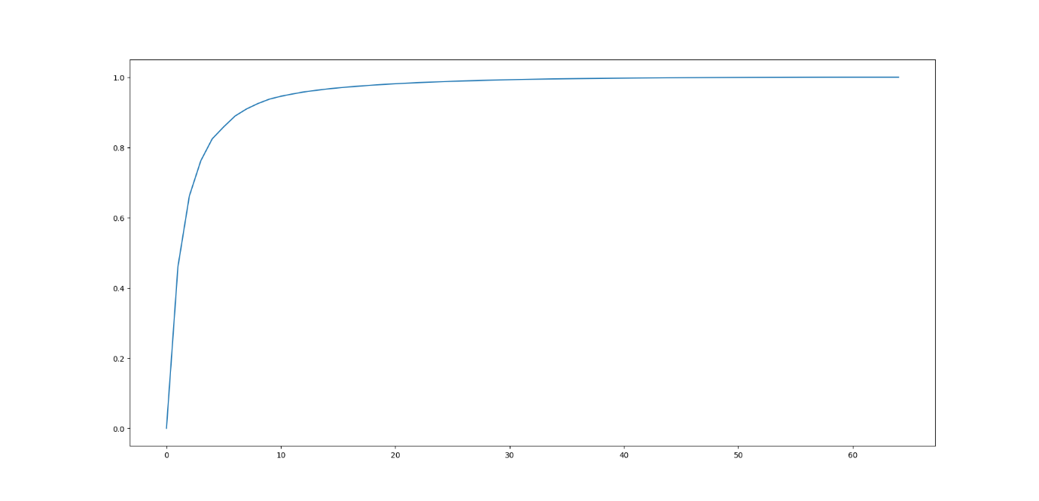
OUTPUTS OF THE ABOVE PROGRAM
First figure respresent the variance of the principal components
Second figure is the cummulative sum of variance

Slide 17
ICA
Independent Component Analysis is a powerful tool for eliminating several important types of non-brain artifacts from EEG data ICA allows the user to reject many Such artifacts in an efficient and user-friendly manner Independent component analysis was originally developed to deal with problems that are closely related to the cocktail-party problem.
Independent Component Analysis is a powerful tool for eliminating several important types of non-brain artifacts from EEG data ICA allows the user to reject many Such artifacts in an efficient and user-friendly manner Independent component analysis was originally developed to deal with problems that are closely related to the cocktail-party problem.
ICA can reveal interesting information on brain activity by giving access to its independent components.
It turns out that the artifacts are quite independent from the rest of the signal, and thus even this requirement of the model is reasonably well fulfilled.
Determination of the components with eye movement artifacts is aided by spatial topography of the components Independent Component Analysis (ICA)
ICA has been used for Feature Extraction, in which case it seems to adequately model the basic cortical processing of visual and auditory information. New application areas are being discovered at an increasing pace.

Slide 18
Code for ICA
import Lbeep
import numpy as np
import pandas as pd
import matplotlib.pyplot as plt
import mne
from sklearn.preprocessing import StandardScaler
from sklearn.decomposition import PCA
d=Lbeep.read_cnt('mn.cnt')
s=d.get_sample_count()
fs=d.get_sample_frequency()
c=d.get_samples(1,s)
q=np.array(c)
q1=q.reshape(962335,64)
ch_names=['GND','FP1','FP2','FPz','AFz','AF3','AF7','AF4','AF8','Fz','F2','F4','F6','F8','F1','F3','F5','F7','FCz','FC2','FC4','FC6','FT8','FC1','FC3','FC5','FT7','Cz','C2','C4','C6','T8','C1','C3','C5','T7','CPz','CP2','CP4','CP6','TP8','CP1','CP3','CP5','TP7','Pz','P2','P4','P6','P8','P1','P3','P5','P7','PO3','PO5','PO7','POz','PO4','PO6','PO8','Oz','O1','O2']
info = mne.create_info(ch_names, 1024, ch_types=["eeg"] * 64)
raw = mne.io.RawArray(q1.T, info)
raw.set_montage("standard_1020")
raw_tmp = raw.copy()
raw_tmp.filter(1, None)
ica=mne.preprocessing.ICA(method="extendedinfomax",random_state=1)
ica.fit(raw_tmp)

Slide 19
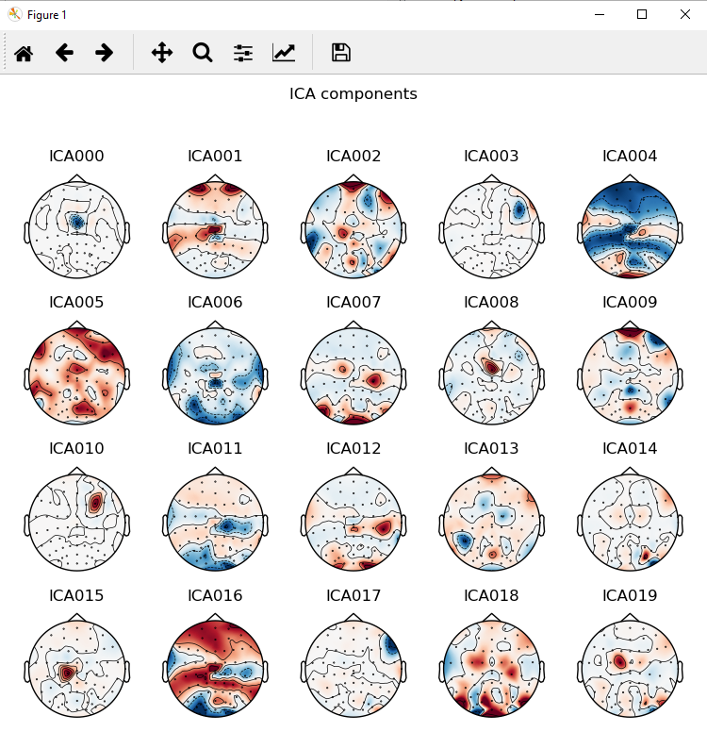
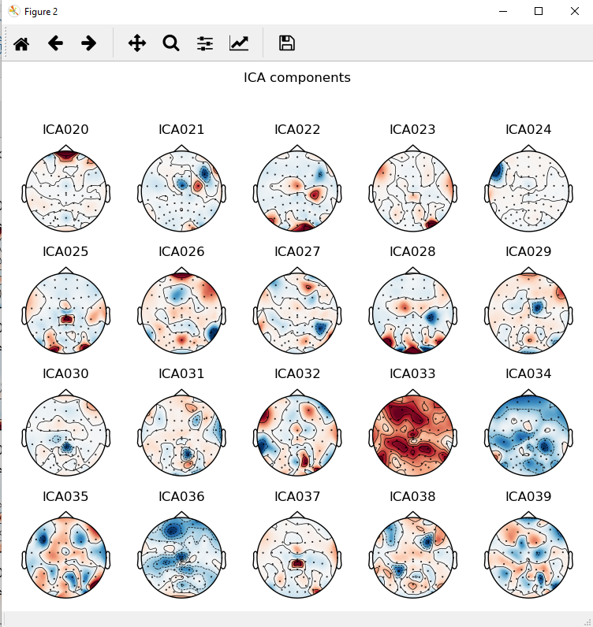
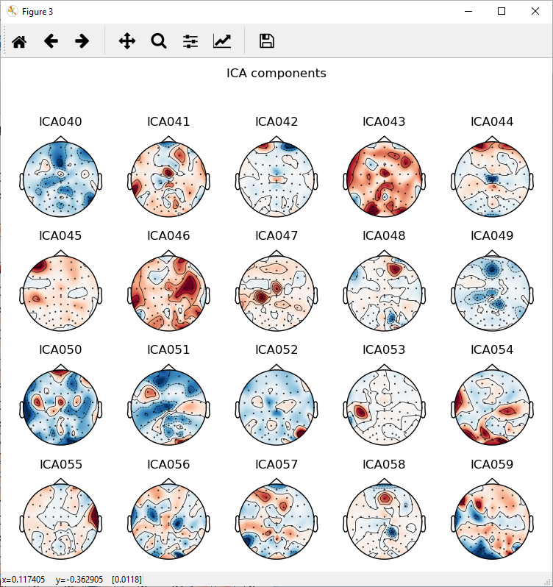
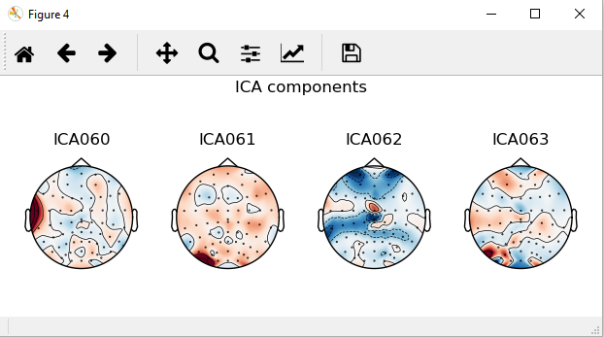

Slide 21
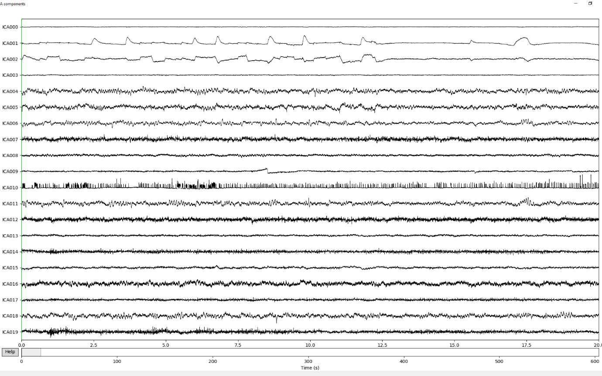
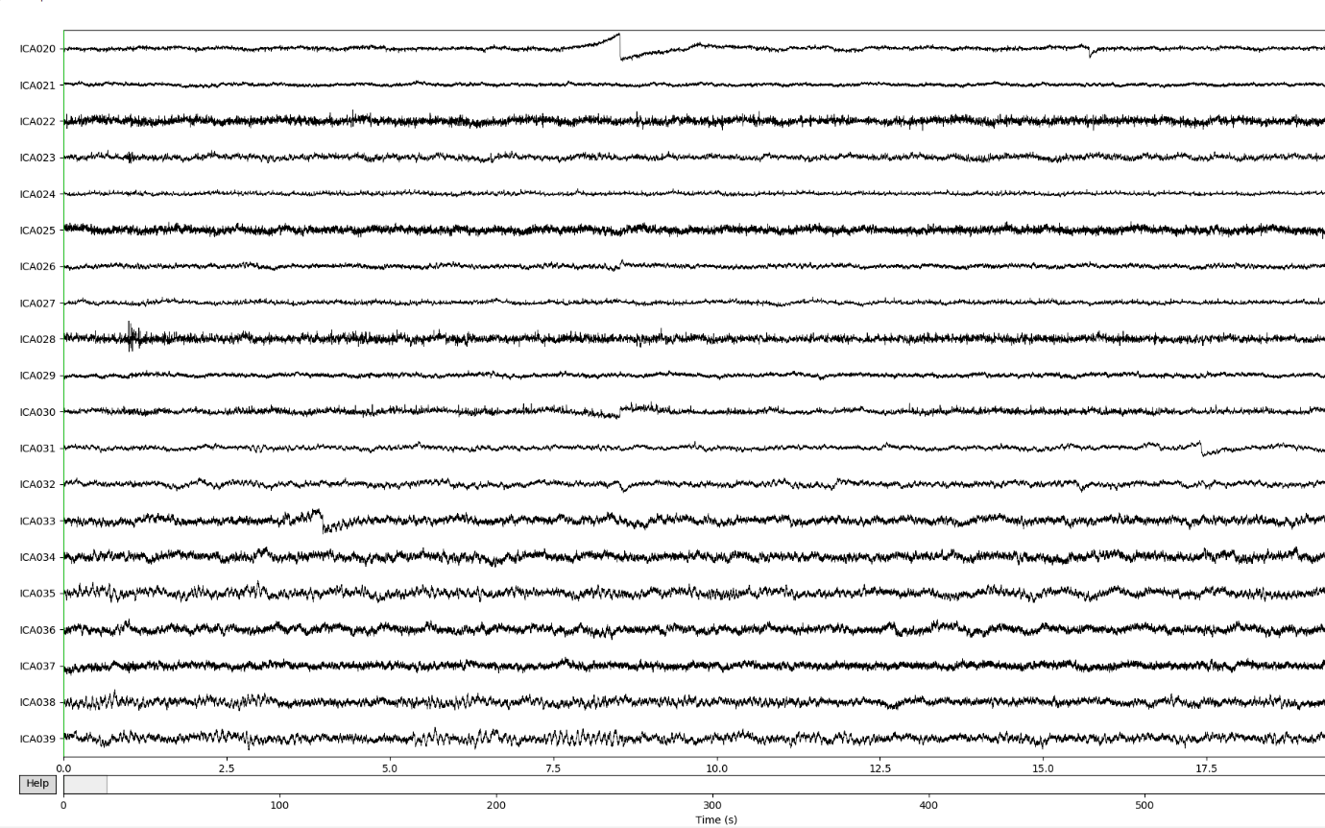

Slide 22
